Slide 1
TV SHOWS & MOVIES NETFLIX
Clelia Chelmi
Katerina Psallida
Lilly Kolliniati

Slide 2

TABLE OF CONTENTS
01
02
03
04
Introduction
Analysing the data
Business case
Areas of investigation
Genres – Duration Directors
Summary
Closing
Conclusions
Recommendations
Q&A
Appendix

Slide 3

01
Introduction

Slide 4



Business case
Who we are: Film industry consultants
Audience:
Netflix management teams
Film and movie producers
Advertising agencies
Goal: Recommendations for Netflix’s next year’s catalogue

Slide 5
Areas of investigation
Genres
Content type
Most popular genres
Further analysis on a move or show level
Components of a successful film or a successful show.
Director
Most popular director

Slide 6
02
Analysing the data

Slide 7
I.
Genres Analysis

Slide 8


Subset explanation
We have created a subset with the content release since 2015. The popular streaming platform started gaining traction after 2015. Since then, the amount of content added has been increasing significantly. Therefore we performed analysis on data acquired from 2015 onwards.

Slide 9
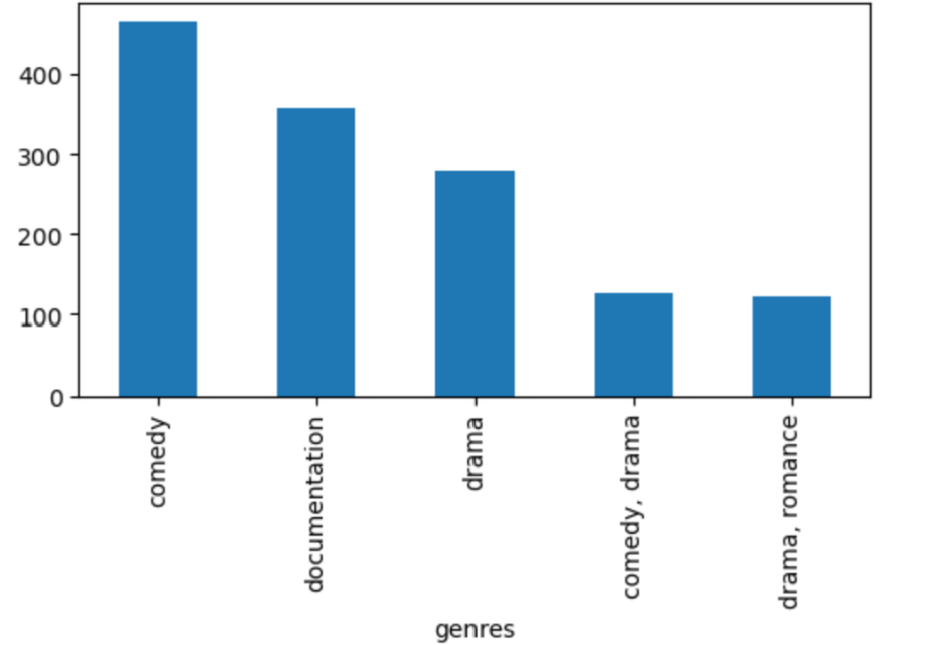
Genres Most popular genres in the catalogue

Slide 10
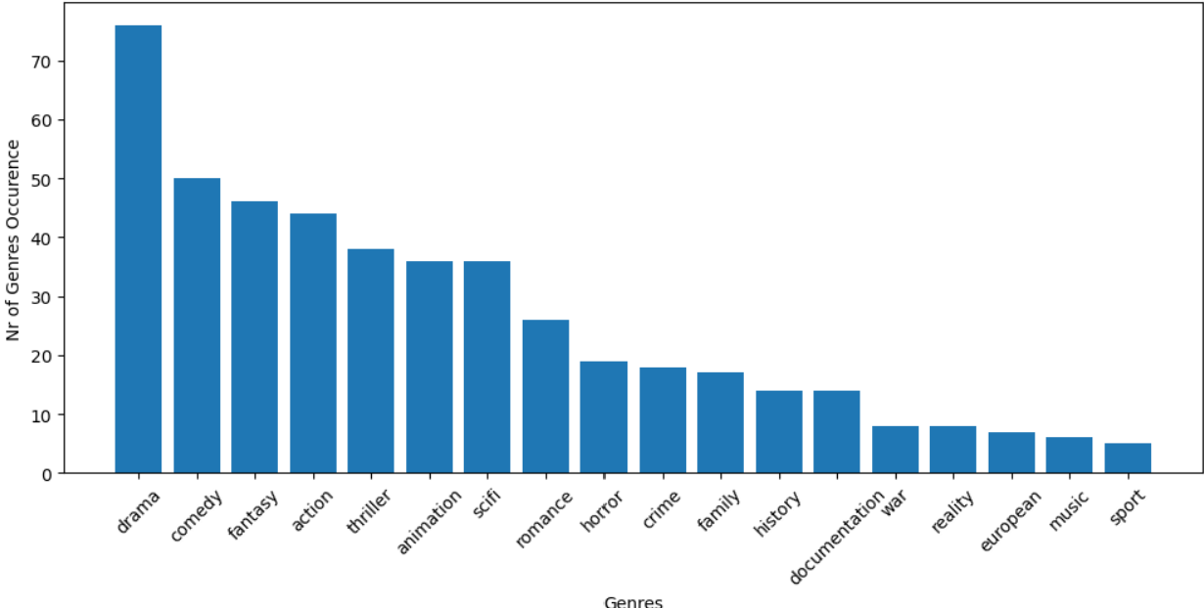
Genres Most highly rated based on IMDB score

Slide 11
II.
Content type Analysis

Slide 12
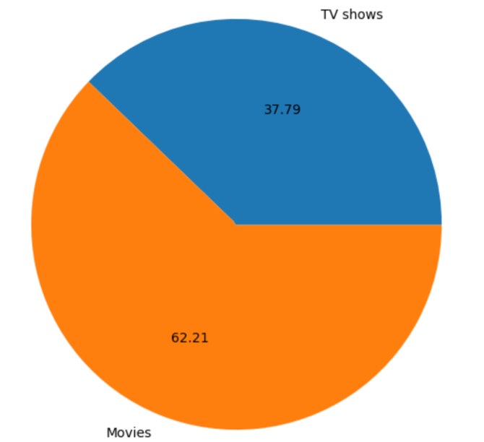
Content type Content type split of the catalogue

Slide 13
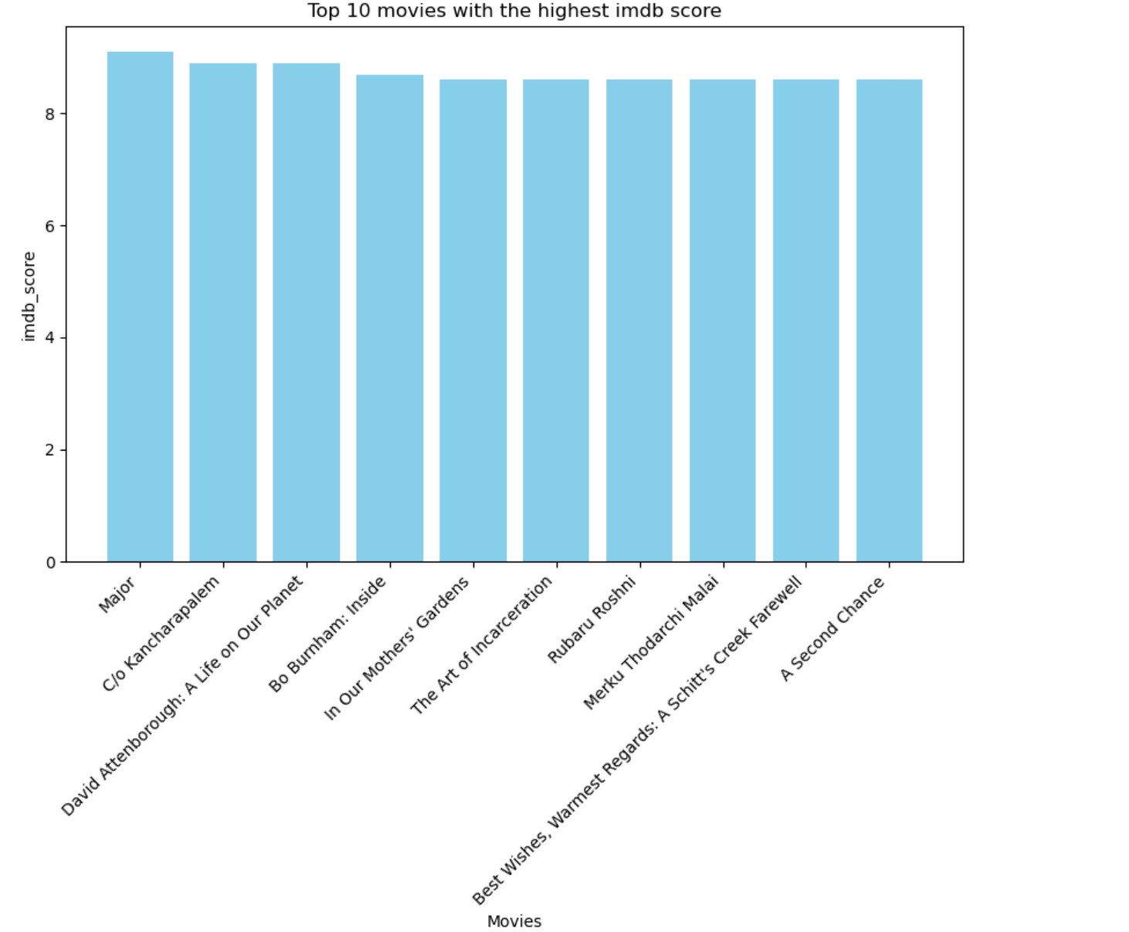
Content type – Movies Most popular films based on IMDB score

Slide 14
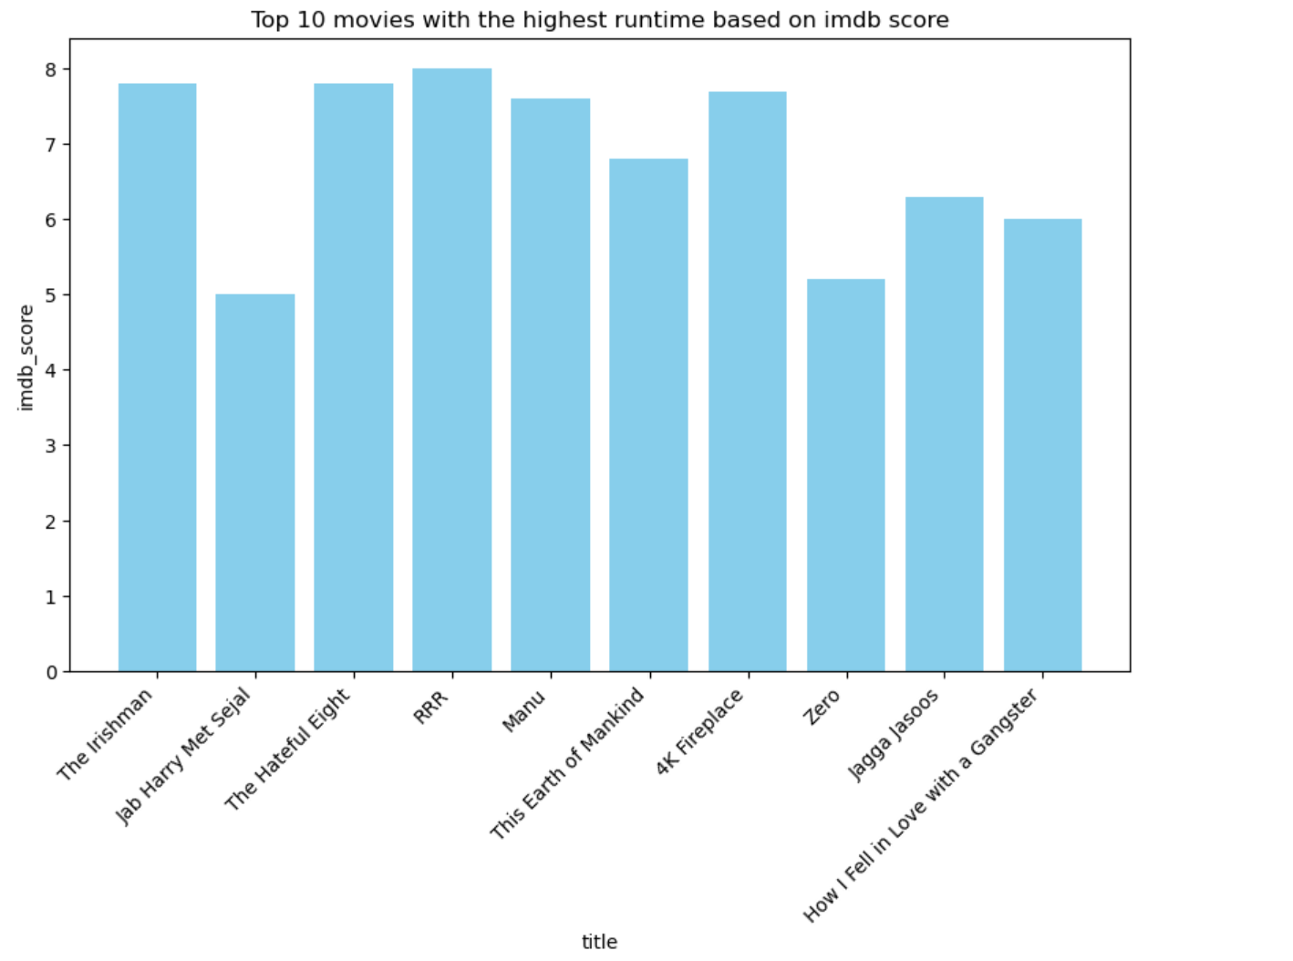
Content type – Movies Film duration and ratings
Film duration > 3hours: 7 films
Film duration > 2hours: 441 films
80% of films have duration < 2hours

Slide 15
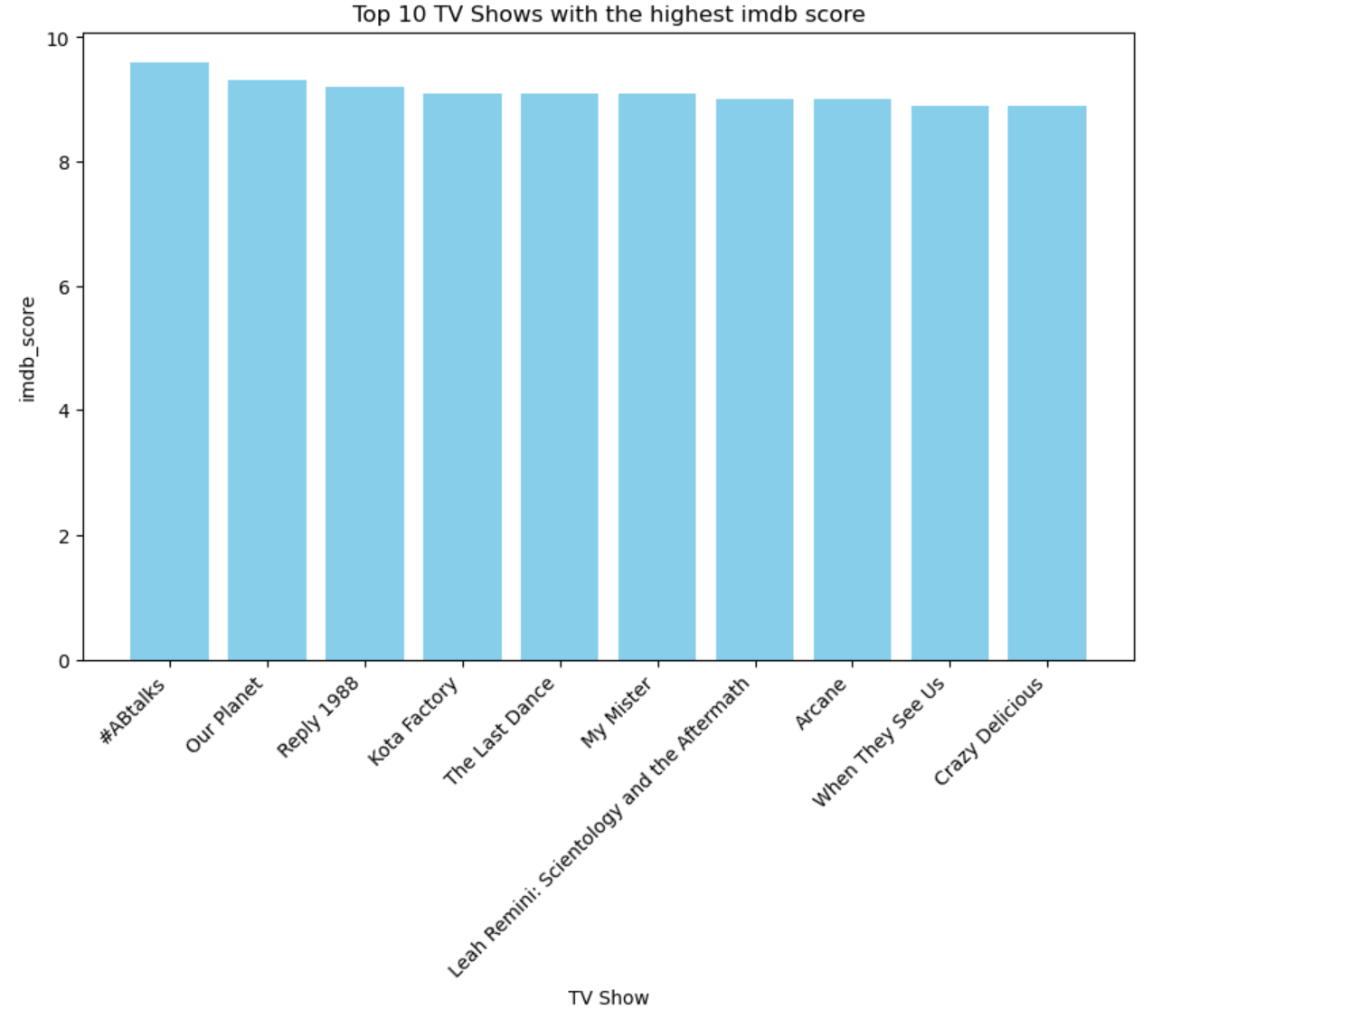
Content type – TV Shows Most popular TV Shows based on IMDB score

Slide 16
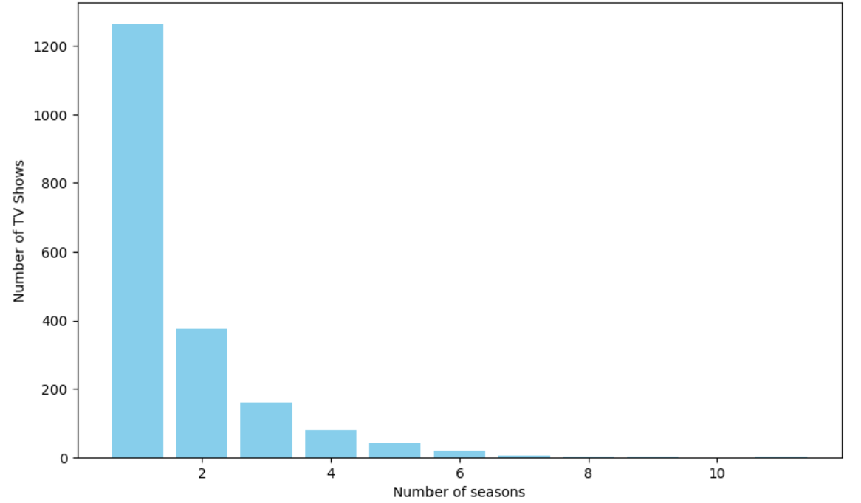
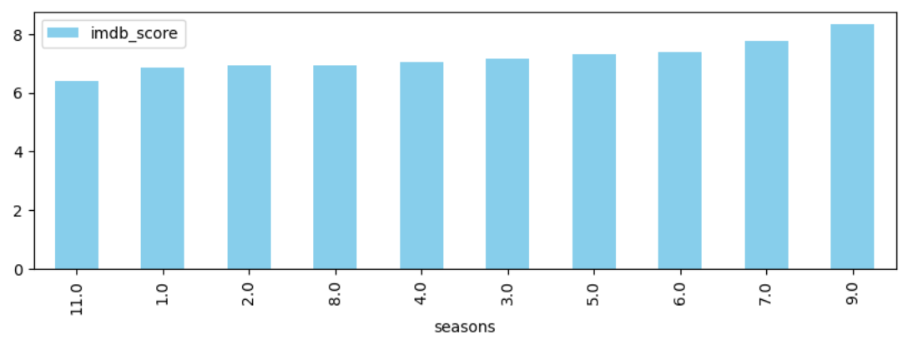
Content type – TV Shows TV Shows seasonality and ratings

Slide 17
III.
Director Analysis

Slide 18
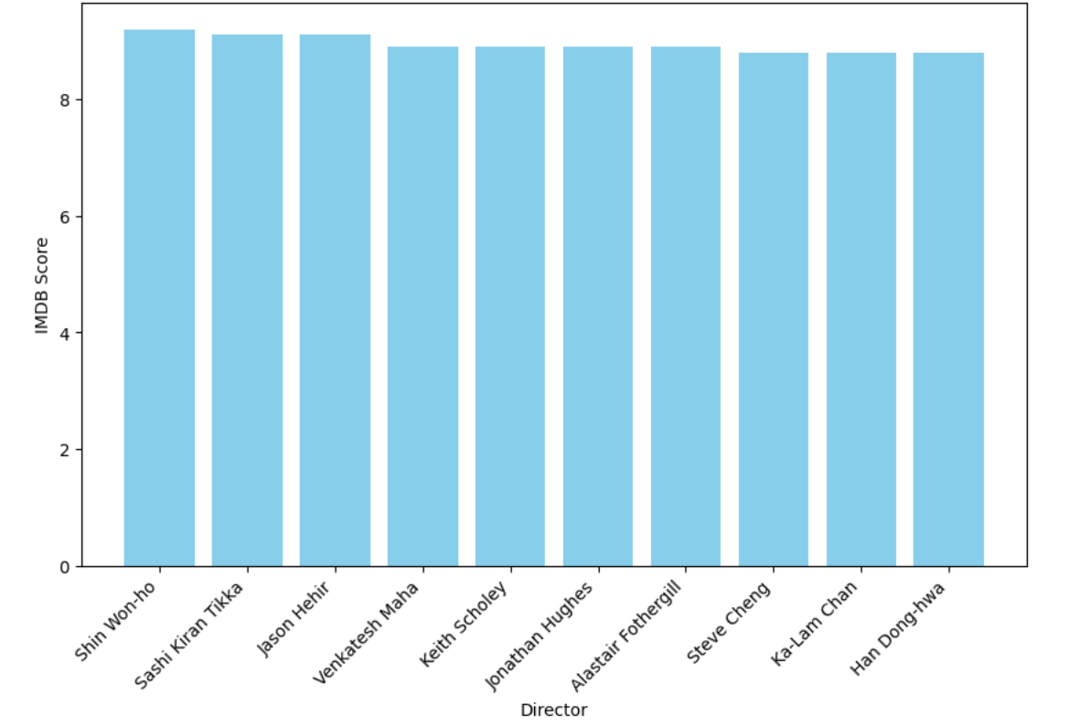
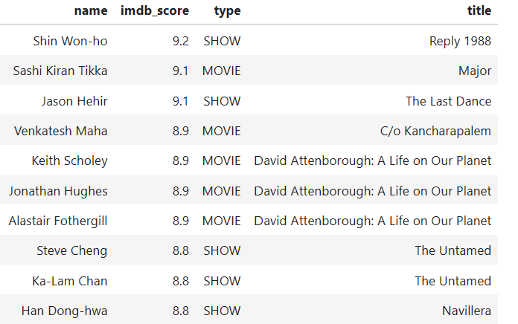
Directors Most popular directors based on IMDB score

Slide 19
03
Summary

Slide 20
Conclusions
Conclusion 1
Conclusion 2
Conclusion 3
To finish the slide

Slide 21
04
Closing

Slide 22
APPENDIX
Resources
https://www.kaggle.com/datasets/victorsoeiro/netflix-tv-shows-and-movies
Disclaimers
IMDB score values are as depicted on the dataset and not any weighted value
Github links
CC link:
KP link:
Lilly Kolliniati: https://github.com/lillykolliniati/Git-project-1-

Slide 23
THANKS!
Do you have any questions?
Please keep this slide for attribution

